Slide 1
2021 NTCA Update
Donna hope wegener
SE TB Controllers Annual meeting
October 2021

Slide 2
Overview of Update
2021-2022 Leadership
Recent Publications and Activities
FYI -- Upcoming NTCA Activities

Slide 3
2021-2022 Board Leadership
Executive Committee
Sarah Gordon – President
Heidi Behm – President-elect
(Newly Elected)
Pete Dupree – Past President
Jason Cummins – Secretary
(Newly Elected)
Sandra Morris -- Treasurer
Section Leadership
Shu Wang – NSTC
Nadya Sabuwala – NTNC
Katelynne Gardner Toren – SETC
Burden Representatives
High
Joe Burzynski (Term Extended)
Monica Pecha (Newly Elected)
Medium
Chima Mbakwem
Amy Painter (Newly Elected)
Low
Christine Hahn
Kristin Bertrang (Newly Elected)

Slide 4
2021-2022 Section Leadership
NTNC
Nadya Sabuwala – President
Lana Dov – President-elect (Newly Elected)
Maureen Murphy-Weiss – Past President
Daniella Ingram – Secretary
Darlene Morse – Low Burden (Newly Elected)
Eric Wicklund– Medium Burden
Elizabeth Foy – High Burden

Slide 5
2021-2022 Section Leadership
NSTC
Shu Wang – President
Connie Haley – President-elect (Newly Elected)
Jon Warkentin – Past President
Michelle Haas – Secretary

Slide 6
2021-2022 Section Leadership
SETC
Katelynne Garden Toren – President
Jenni Wheeler – President-elect (Newly Elected)
Shona Smith – Past President
Evan Timme – Secretary (Term Extended)
LaTweika Salmon – High Burden (Newly Elected)
Jesse Ellis – Medium Burden (Newly Elected)

Slide 7
Recent publications and Activities

Slide 8

LTBI Clinical Recommendations
Posted on the NTCA website:
www.tbcontrollers.org/ resources/ltbi/clinical_recommendations
Developed by TB clinicians across the United States

Slide 9
TB Nurse Core Competencies
Foundation for:
Revision of NTCA’s Comprehensive TB Nurse Manual
Development of a National TB Nurse Certificate

Slide 10
Newest Resource for Programs
Recent Topics:
TB Care Directory – soon-to-be-released by DGMQ
CureTB and MCN TB Net
Developing the APR due 08.31.21

Slide 11
upcoming Activities

Slide 12

Next Steps for NTCA
OUR WORK IS ALL ABOUT
PARTNERSHIPS
AND COLLABORATIONS
…we are stronger together!

Slide 13
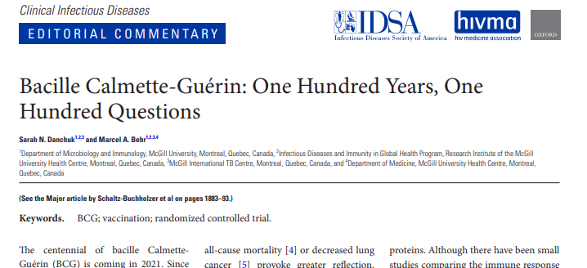
BCG vaccine: Centennial Anniversary

Slide 14
Develop NTCA BCG Vaccination Toolkit
Clinical Guidance – Indications; Clinical management; Adverse Effects
NTCA – NSTC physicians; BCG SMEs
Nursing Practice – Administration; Infection Prevention
NTCA – NTNC nurses
Program Administration – Procurement Access: Regulations
NTCA – TB program managers; NTCA program staff
Post on NTCA website

Slide 15
TB Nurse Case Management
Revision of the Comprehensive TB Nurse Manual
Initiation of a TB Nurse Journal Club (monthly)
Creation of a National TB Nurse Certificate

Slide 16
LTBI: Clinical Recommendations
Developed as a “living document”
Reviewed and updated q6 months
Exploring options for additional physician education and dissemination activities

Slide 17
TB and COVID-19 Workgroup
NTCA/CDC DTBE collaboration
Voluntary data collection activity
TB-COVID co-infection surveillance and clinical manifestations

Slide 18
Nitrosamine Impurities
Continued conversations with FDA and rifampin and rifapentine manufacturers
Development of provider and patient educational materials
TAG resources as foundation
Infographic format ??

Slide 19
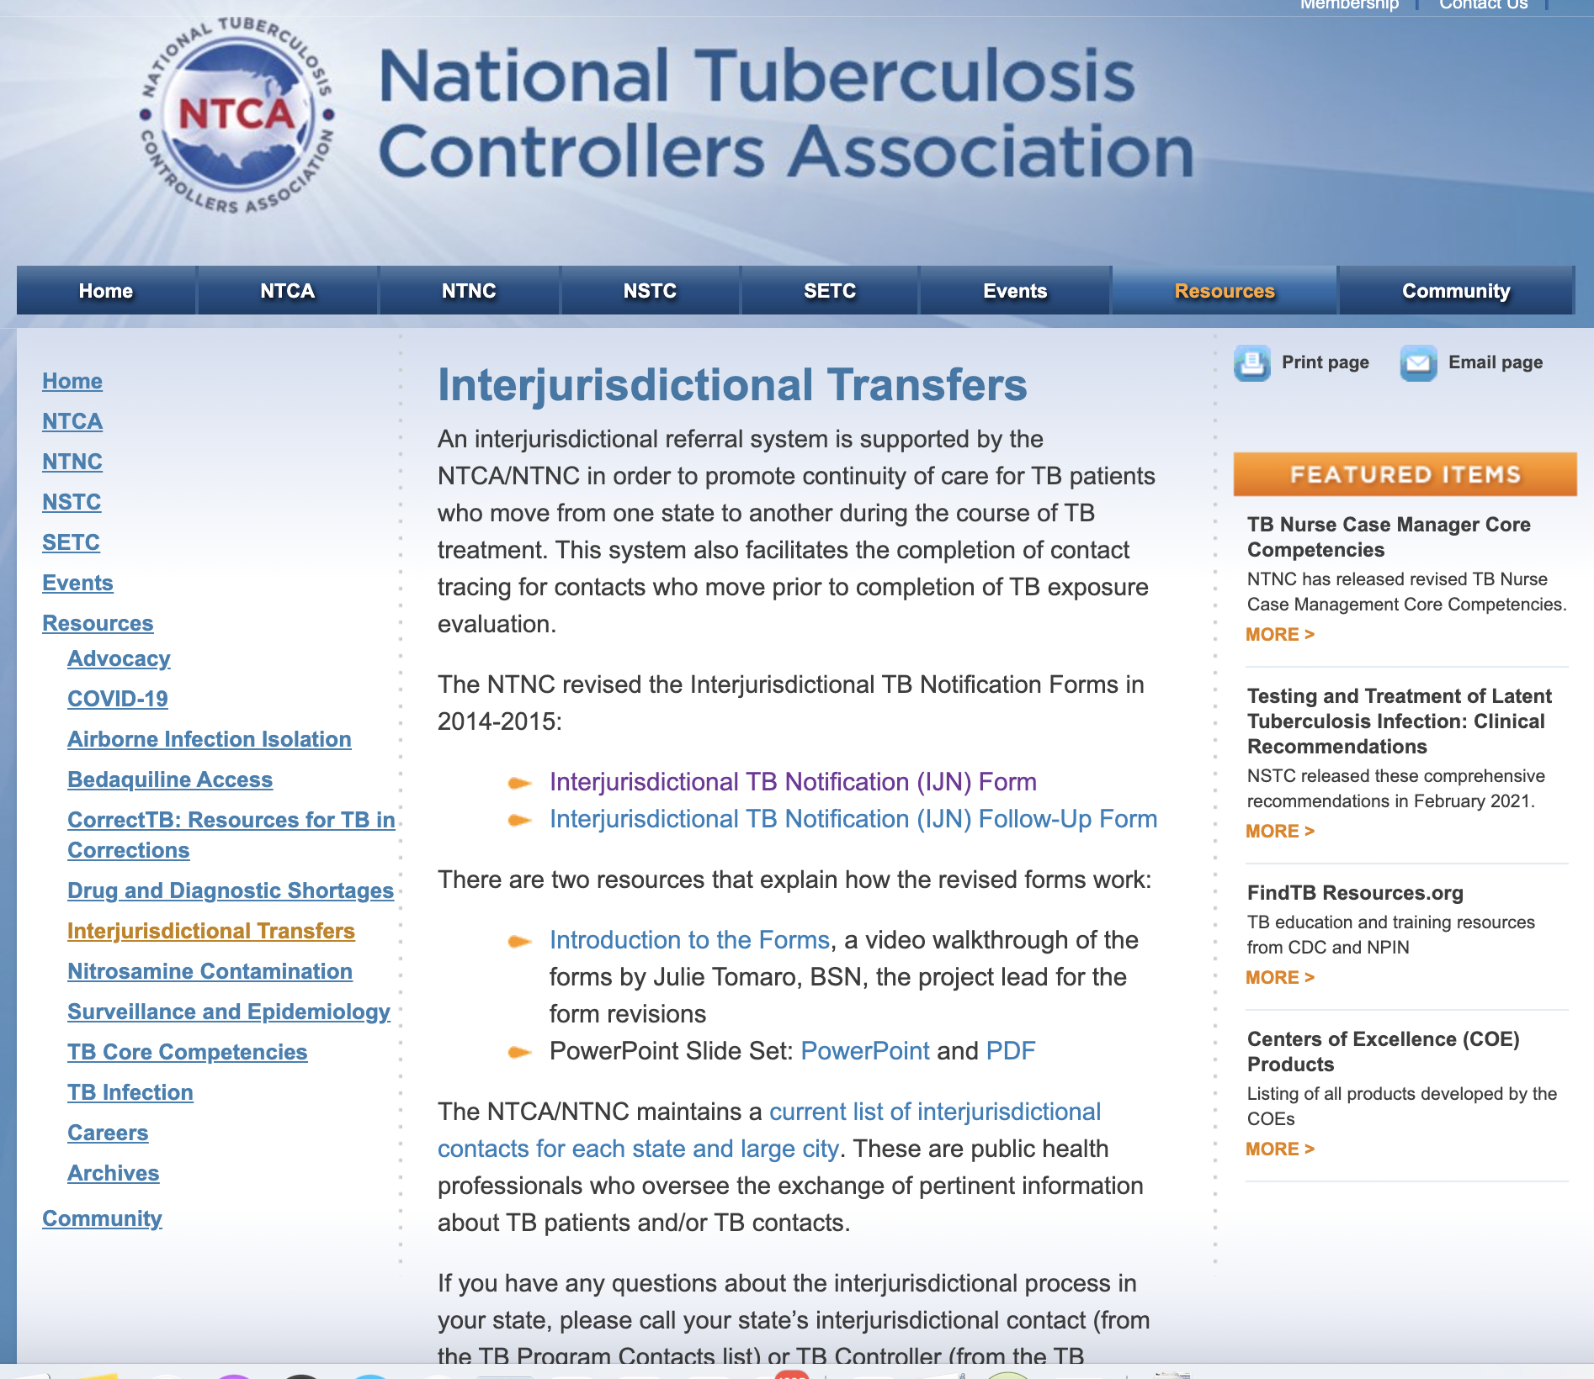
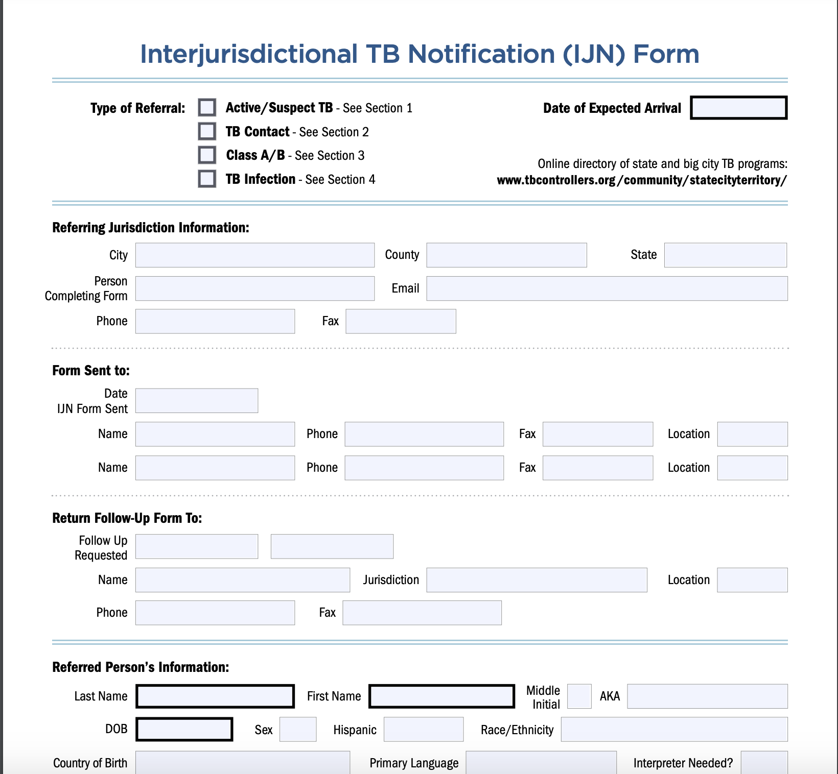
Inter-Jurisdictional Notification Form
REVISIONS UNDERWAY!
Anticipated release date:
12/2021

Slide 20
Additional Activities Planned
In-person (?) 2022 National TB Conference
Collaboration with CTCA
Community of Practice for Program Managers for LHJs and for programs in low burden areas
Partnerships continue
We are TB
NACCHO
Stop TB USA
TB Roundtable – DC-based advocacy group
NEW: Collaboration with the National Milk Producers Federation
Bovine tuberculosis working group
Webinar on recent outbreaks involving humans and cattle

Slide 21
Thank you!

